Slide 1
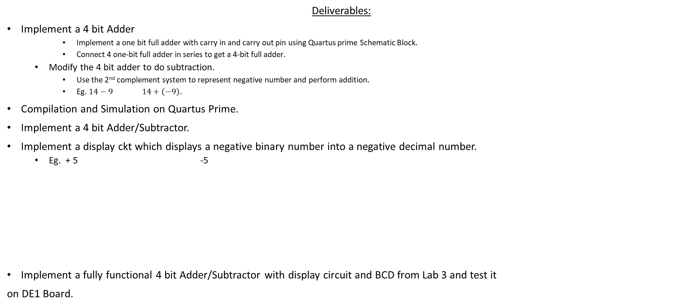
LAB-3. 4 Bit Adder- 4 Bit Subtractor
Deliverables:
Implement a 4 bit Adder
Implement a one bit full adder with carry in and carry out pin using Quartus prime Schematic Block.
Connect 4 one-bit full adder in series to get a 4-bit full adder.
Modify the 4 bit adder to do subtraction.
Use the 2nd complement system to represent negative number and perform addition.
Eg. $14−9$ $14+\left(−9\right).$
Compilation and Simulation on Quartus Prime.
Implement a 4 bit Adder/Subtractor.
Implement a display ckt which displays a negative binary number into a negative decimal number.
Eg. + 5 -5
Implement a fully functional 4 bit Adder/Subtractor with display circuit and BCD from Lab 3 and test it
on DE1 Board.
LAB 3
LAB 4

Slide 2
Binary Addition
Binary 1 bit addition
0 + 0 = 0
1 + 0 = 1
0 + 1 = 1
1 + 1 = 0 with carry out of 1.
When implement adder using logic gates, we need to add the carry input (from the previous bit) and carry out output.
Eg.
1
0
0
1 1 0 1
+ 1 1 1 0
1
1
0
1
1

Slide 3
Binary Addition
Binary 1 bit addition
0 + 0 = 0
1 + 0 = 1
0 + 1 = 1
1 + 1 = 0 with carry out of 1.
When implement adder using logic gates, we need to add the carry input (from the previous bit) and carry out output.
Eg.
Carry out
Carry out
Carry Out
Carry In
Carry In
Carry In
1
0
0
1 1 0 1
+ 1 1 1 0
1
1
0
1
1
Carry Out

Slide 4


1 Bit Full Adder
X
1 bit adder
Sum
Y
Cout
Cin
X | Y | Cin | Sum | Cout
0 | 0 | 0 | 0 | 0
0 | 0 | 1 | 1 | 0
0 | 1 | 0 | 1 | 0
0 | 1 | 1 | 0 | 1
1 | 0 | 0 | .. | ..
1 | 0 | 1 | .. | ..
1 | 1 | 0 | .. | ..
1 | 1 | 1 | .. | ..
$Sum=$????
$$Cout= ????$$

Slide 5


4 Bit Adder
Cout2
Cout1
Cout0
Cin3
Cin2
Cin1
Cin
A3 A2 A1 A0
+ B3 B2 B1 B0
Cout
Q3
Q2
Q1
Q0
Block diagram of a 4 bit adder .
$$A_{0}$$
Four 1 bit adders in series to get a 4 bit adder.
$$A_{1}$$
4 bit adder
$$Q_{0}$$
$$A_{2}$$
$$Q_{1}$$
$$A_{3}$$
$$Q_{2}$$
$$A_{3}$$
X
1 Bit Adder
$$B_{0}$$
$$Q_{3}$$
Sum
$$Q_{3}$$
$$A_{2}$$
$$B_{3}$$
Y
$$B_{1}$$
$$C_{out}$$
X
1 Bit Adder
$$B_{2}$$
$$B_{2}$$
Sum
$$B_{3}$$
Y
$$Q_{2}$$
Cin3
Cout
$$C_{out}$$
$$A_{1}$$
X
1 Bit Adder
Sum
$$Q_{1}$$
$$B_{1}$$
Y
Cin2
Cout2
$$A_{0}$$
X
1 Bit Adder
$$Cin$$
Sum
$$Q_{0}$$
$$B_{0}$$
Y
Cin1
Cout1
$$Cin$$
Cin
Cout0

Slide 6






2nd Complement
Binary representation of a negative number.
Eg.
In the 2nd complement system, MSB is used as a sign bit.
MSB = 0 represents the binary number is a positive integer.
MSB = 1 represents the binary number is a negative integer.
Binary Bit can represent positive integer and negative integer.
Eg. 4 bit binary number can represent up to (0-7) and (-1 to -8)
$$5$$
$0 1 0 1$
$1 0 1 0$
$+ 1$
- $5$
$1 0 1 1$

Slide 7
Example of Negative Number Representation for 4 bit system in 2nd Complement
Binary |  |  |  | Integer
0 | 0 | 0 | 0 | 0
0 | 0 | 0 | 1 | 1
0 | 0 | 1 | 0 | 2
0 | 0 | 1 | 1 | 3
0 | 1 | 0 | 0 | 4
0 | 1 | 0 | 1 | 5
0 | 1 | 1 | 0 | 6
0 | 1 | 1 | 1 | 7
1 | 0 | 0 | 0 | -8
1 | 0 | 0 | 1 | -7
1 | 0 | 1 | 0 | -6
1 | 0 | 1 | 1 | -5
1 | 1 | 0 | 0 | -4
1 | 1 | 0 | 1 | -3
1 | 1 | 1 | 0 | -2
1 | 1 | 1 | 1 | -1

Slide 8






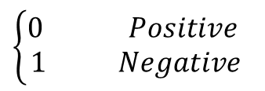







4 Bit Subtractor
$$X_{0}$$
$$X_{1}$$
4 Bit Add/
Subtractor
$$Q_{0}$$
$$X_{2}$$
$$Q_{1}$$
$$X_{3}$$
$$Q_{2}$$
$$Q_{3}$$
$$Y_{0}$$
$$Y_{1}$$
$$Y_{2}$$
Sign Bit
$$Y_{3}$$
$$Sign Bit$$
$\left\{\begin{aligned}0 Positive \\ 1 Negative\end{aligned}\right.$

Slide 9



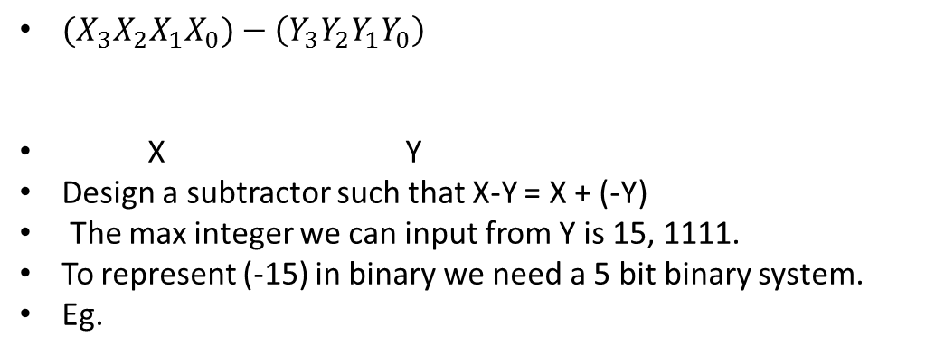






4 Bit Subtractor
${(X}_{3}X_{2}X_{1}X_{0})−\left(Y_{3}Y_{2}Y_{1}Y_{0}\right)$
X Y
Design a subtractor such that X-Y = X + (-Y)
The max integer we can input from Y is 15, 1111.
To represent (-15) in binary we need a 5 bit binary system.
Eg.
$$15$$
$1 1 1 1$
$0 0 0 0$
$+ 1$
This is wrong!!!!
$0 0 0 1$
$$15$$
$0 1 1 1 1$
$1 0 0 0 0$
In a 4 bit system, add one MSB bit for Sign Bit
$+ 1$
-15 in Binary..
$1 0 0 0 1$
Sign Bit

Slide 10

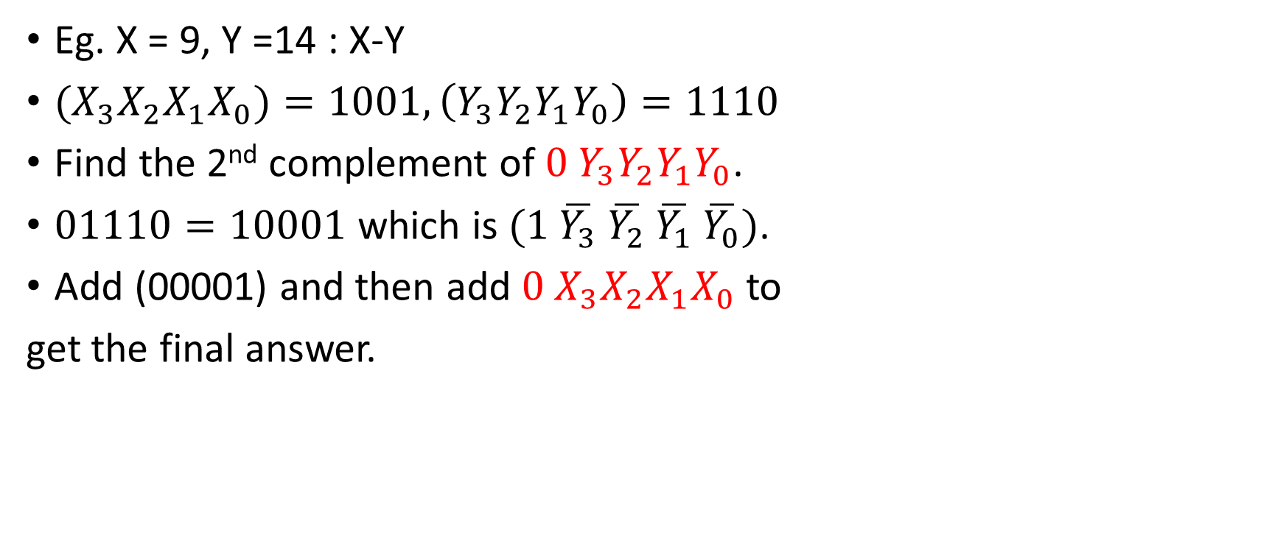




4 Bit Adder/Subtractor
Eg. X = 9, Y =14 : X-Y
${(X}_{3}X_{2}X_{1}X_{0})=1001, \left(Y_{3}Y_{2}Y_{1}Y_{0}\right)=1110$
Find the 2nd complement of ${0 Y}_{3}Y_{2}Y_{1}Y_{0}$.
$01110=10001$ which is $(1 \overline{Y_{3}} \overline{Y_{2}} \overline{Y_{1}} \overline{Y_{0}})$.
Add (00001) and then add ${0 X}_{3}X_{2}X_{1}X_{0}$ to
get the final answer.
$$10001$$
$+ 00001$
-14
$$10010$$
$$+01001$$
-5
$$11011$$
Sign bit tells the result is a negative number.

Slide 11


Sign Bit
$$10001$$
$+ 00001$
-14
$$10010$$
Sign bit = 0+1+ carry out from (X3+Y3’).
= 1+carry out from (X3+Y3’).
$$+01001$$
-5
$$11011$$
Carry Out from (A3+B3’) | Sign Bit
1 | 0
0 | 1
Therefore, from the truth table above, Sign Bit = Not Carry out from (A3+B3’).

Slide 12








4 Bit Subtractor
Block diagram of a 4 bit subtractor using 4 bit adder .
$$A_{0}$$
$$A_{1}$$
4 bit adder
$$Q_{0}$$
$$A_{2}$$
$$Q_{1}$$
$$A_{3}$$
$$Q_{2}$$
$$A_{3}$$
$$B_{3}$$
X
1 Bit Adder
$$B_{0}$$
$$Q_{3}$$
Sum
$$Q_{3}$$
$$B_{1}$$
$$Sign bit$$
$$A_{2}$$
Y
$$B_{2}$$
X
1 Bit Adder
$$B_{2}$$
Sum
$$B_{3}$$
Y
$$Q_{2}$$
Cin3
Cout
$$Sign bit$$
$$A_{1}$$
X
1 Bit Adder
$$B_{1}$$
Sum
$$Q_{1}$$
$$A_{0}$$
Y
Cin2
Cout2
X
1 Bit Adder
$$Cin$$
$$B_{0}$$
Sum
$$Q_{0}$$
$$1$$
Y
Cin1
Cout1
$$1$$
$$Cin$$
Cin
Cout0

Slide 13
Try to design 4 Bit Adder/Subtractor
Modify the 4-bit Adder to a 4-bit Adder/Subtractor.
Use four 2:1 Muxs and 4-bit adder to implement 4-bit Adder/Subtractor.

Slide 14
Project Flow Chart
Implement a 1-bit Adder.
Simulate 1 1-bit adder (Screenshot the result and add it to the report).
Implement a 4-bit Adder.
Simulation waveform on Quartus Prime (Screenshot the result and add it in the report.)
Modify the 4-bit Adder to a 4-bit Sub.
Simulation waveform on Quartus Prime. (Screenshot the result and add it to the report.)

Slide 15
Report
Follow the sample report for details.
Objective (10 points)
Equipment (10 points)
Description(10 points)
Design Synthesis (20 points)
Kmaps and Boolean Expressions
Complete logic Diagram from Quartus(20 points)
Screenshot of your Complete Circuit block diagram
Results and Simulation (10 points)
Simulation Screenshot with a clear explanation.
Screenshots for 1-bit adder, 4 bit adder, 4 bit sub/add.
Conclusion (20 points).

